Slide 1
3D Mapping MapInfo Pro
Parth Chaturvedi

Slide 2
TABLE OF CONTENTS
01
02
INTRODUCTION
ABOUT GML
03
04
TECHNOLOGIES USED
DEMO

Slide 3
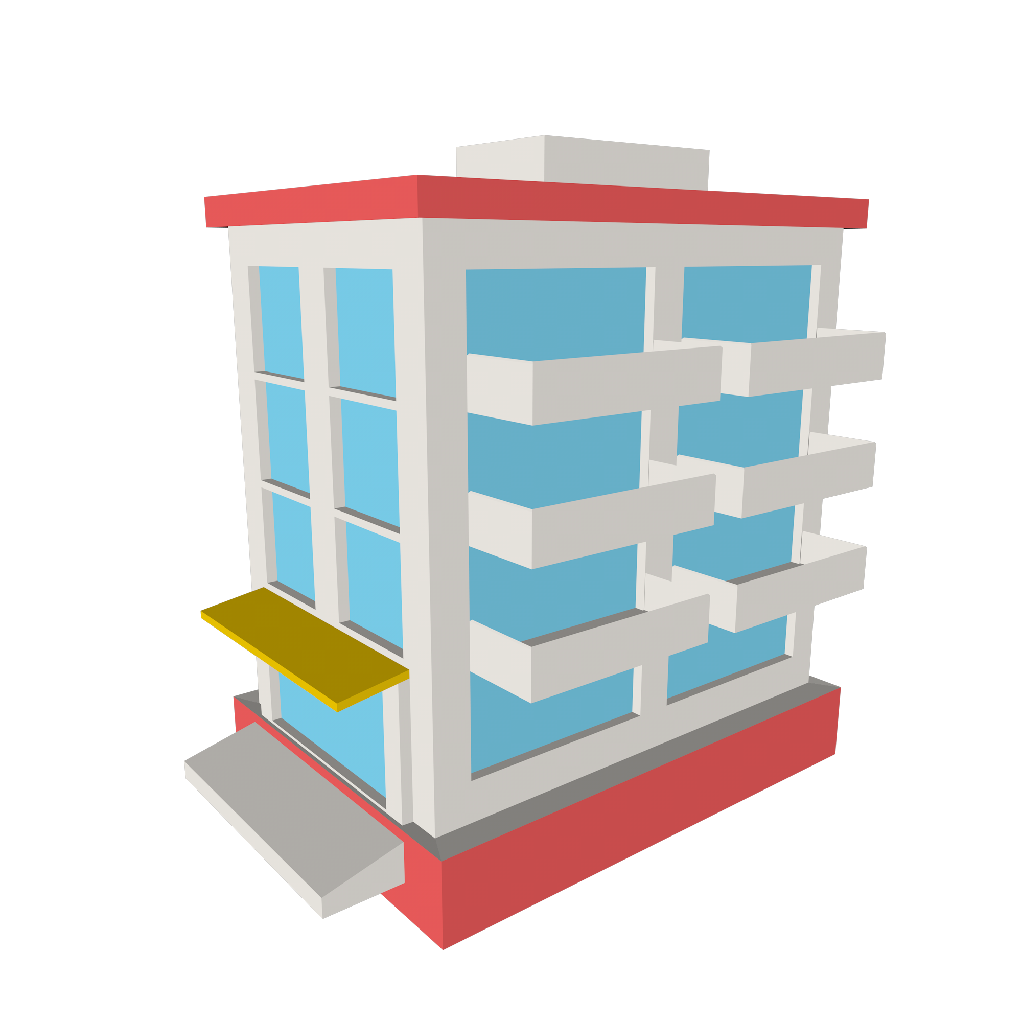
INTRODUCTION
This program reads files containing 3D models of cities stored inside data models and renders them into a 3D Window.
This a command line tool and a mapinfo pro add-in as well.

Slide 4
2
ABOUT GML

Slide 5

WHAT IS GML
XML based encoding standard for geographic information.
Concerned with the representation of the geographic data content.
A simple text based encoding of geographic features.

Slide 6

CITYGML
The CityGML City Geographic Markup Language, standard defines a conceptual model and exchange format for the representation, storage and exchange of virtual 3D city models.
Notes:
It is an exchange format for modeling all parts of a virtual city. It based on GML3 schema (XML based). Not focused on individual buildings it is on a city level, not just being a visulatition tool but model the urban environment.

Slide 7

CITYJSON
JSON-based encoding for storing 3D city models
Compact and developer-friendly format
Easily visualised, manipulated, and edited
Notes:
It is an exchange format for modeling all parts of a virtual city. It based on GML3 schema (XML based). Not focused on individual buildings it is on a city level, not just being a visulatition tool but model the urban environment.

Slide 8




TECHNOLOGIES USED
PYTHON 3.10
VTK 9.1.0
Highly Versatile
Easy to read and write
3D rendering tools
Widgets for 3D interaction
PYQT5
CITYGML-TOOLS
Create complex GUIs
Pre-built designs
Convert cityjson to citygml
Validate files

Slide 9
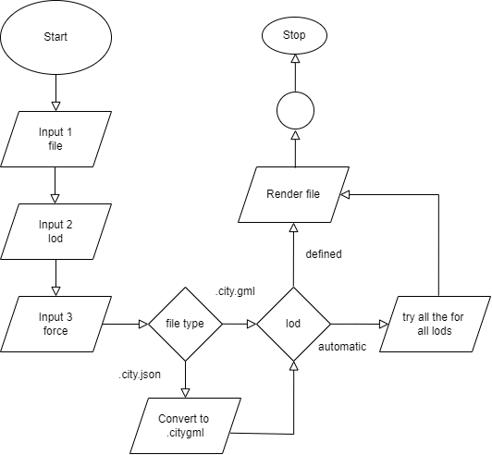
FLOWCHART

Slide 10
4
DEMO

Slide 11
THANKS!
Do you have any questions?

